Slide 1

Latest Microsoft Message Center Updates on Copilot Services
Recent announcements enhancing AI-powered productivity tools
Notes:
AI-generated content may be incorrect. ---

Slide 2
Overview and Criteria
Notes:
Purpose and Selection Criteria

Slide 3

Purpose and Selection Criteria
Presentation Purpose
Summarizes Microsoft Message Center updates focused on 'Plan for change' messages for Copilot services.
Message Selection Criteria
Includes 'Plan for change' messages referencing Copilot, tagged as new features, published after August 1, 2025.
Information Organization
Messages sorted by most recent update date including IDs, titles, descriptions, rollout schedules, and impact levels.
Intended Audience
This deck is designed to inform IT leads and teams to prepare for changes and communicate effectively.
Notes:
This presentation provides a consolidated summary of the latest updates from the Microsoft Message Center, specifically focusing on 'Plan for change' messages related to Microsoft Copilot services. The information is curated to assist IT teams in understanding upcoming changes, new features, and rollout timelines that may impact organizational workflows and user experiences. The selection criteria for the messages included in this deck are as follows: messages must be categorized as 'Plan for change', must reference services containing 'Copilot', must be tagged as 'New Feature', and must have been published on or after August 1, 2025. The messages are sorted by the 'Date Last Updated' in descending order to ensure the most recent updates are presented first. Each slide includes the message ID, title, description, rollout schedule, and whether the change is considered major. This deck is intended to inform IT leads and their teams about relevant changes and help them prepare for implementation or communication within their organizations.

Slide 4
Copilot Chat Enhancements
Notes:
Content Sources in Copilot Chat (MC1127230), Including Files and Emails in Prompts (MC1139488)

Slide 5
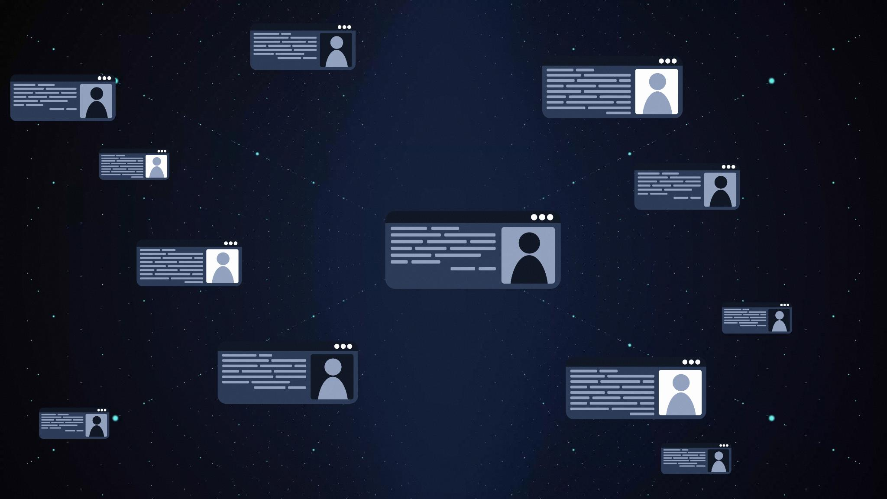
Content Sources in Copilot Chat (MC1127230)
Selectable Content Sources
Users can now choose specific content sources for Copilot Chat to improve response relevance and accuracy.
Rollout Schedule and Default Settings
The feature rolls out from mid-October to late November 2025 and is enabled by default for licensed users.
No Admin or Compliance Impact
No administrative action is required and there are no compliance concerns with this new feature.
Enhanced User Control
This update provides users greater control over AI chat interactions, aligning with user feedback for transparency.
Notes:
Microsoft 365 Copilot introduces a new feature allowing licensed users to select specific content sources for Copilot Chat responses. This enhancement aims to improve the relevance and accuracy of AI-generated responses by enabling users to scope the chat to selected sources. The rollout is scheduled from mid-October to late November 2025 and is enabled by default. No administrative action is required, and there are no compliance concerns. This feature empowers users to have more control over the AI interactions and aligns with feedback requesting more transparent and customizable experiences. The message ID for this update is MC1127230.

Slide 6

Including Files and Emails in Prompts (MC1139488)
Files and Emails Integration
Users can include files and emails in chat prompts by typing '/' to enhance response relevance.
Restricted Email Access
Email integration via '/' is available only in Outlook Copilot Chat to ensure secure access.
Improved Usability and Rollout
This feature improves usability without changing permissions, rolling out from mid to late September 2025.
Notes:
Microsoft 365 Copilot Chat now allows users to include files and emails directly in prompts by typing '/' in the web chat prompt box. This feature enhances the relevance of responses by grounding them in specific user-selected content. Email access via '/' is limited to Outlook Copilot Chat. Suggested prompts may also include relevant files or emails to assist users in getting started. This update improves usability and prompt relevance, and users will only see content they have access to. No changes to default settings or permissions are required. The rollout for email access begins mid-September and completes by late September 2025. The message ID for this update is MC1139488.

Slide 7
Copilot Personalization and Memory
Notes:
Communication Memory in Copilot (MC1127234)

Slide 8

Communication Memory in Copilot (MC1127234)
AI-Powered Memory Integration
Copilot uses AI to remember key highlights from chats, emails, and meetings for personalized cross-application responses.
Privacy and Security
Memories are privately stored in user mailboxes and managed securely with admin controls and user options.
User Control Over Memories
Users can view or delete memories by removing source data, ensuring full control of their information.
Rollout and Admin Management
Feature rollout spans September to October 2025 with admins managing memory through Enhanced Personalization controls via Microsoft Graph.
Notes:
Starting September 2025, Microsoft 365 Copilot will begin using AI to remember key highlights from users' chats, emails, and meetings to provide personalized responses across applications. These memories are private, securely stored in users' mailboxes, and managed via admin controls. Users can view or delete memories by removing the source data. This expanded capability enhances personalization beyond single-app contexts and introduces a unified view across communication channels. Admins can manage memory through Enhanced Personalization controls via Microsoft Graph. The rollout begins early September and completes by late October 2025. The message ID for this update is MC1127234.

Slide 9
Copilot in Word and Document Libraries
Notes:
Copilot in Word for Content Creation (MC1129126), AI Actions in SharePoint Document Libraries (MC1141949)

Slide 10
Copilot in Word for Content Creation (MC1129126)
Enhanced Content Creation
Copilot enables drafting, editing, and transforming Word content directly through chat interaction, enhancing productivity.
User Control and Review
Users maintain control by reviewing and approving content changes generated by Copilot, ensuring accuracy and customization.
Effortless Rollout
The feature rollout requires no admin action and is scheduled for October to November 2025, simplifying adoption.
Notes:
Microsoft 365 Copilot in Word is being enhanced to allow users to create, edit, and transform content directly from chat. Licensed users will be able to draft new documents, reorganize content into formats like FAQs, update existing content, or rewrite sections. Users maintain control over the content and can review and approve changes. The rollout is scheduled from October to November 2025 and requires no admin action. This feature streamlines document creation and editing through a conversational experience. The message ID for this update is MC1129126.

Slide 11

AI Actions in SharePoint Document Libraries (MC1141949)
Expansion of AI Actions
AI file actions are now available in SharePoint document libraries, extending capabilities beyond OneDrive.
Features Enabled by Copilot Licenses
Users can summarize content, compare files, generate FAQs, ask questions, and create audio overviews using AI.
Rollout and Controls
This AI feature rollout begins mid-September 2025 with compliance and access control measures in place.
Enhanced Productivity
Natural language interactions with files boost user productivity and ease of file management.
Notes:
AI file actions, previously available in OneDrive, are expanding to SharePoint document libraries. Users with Copilot licenses will be able to summarize content, compare files, generate FAQs, ask questions, and create audio overviews directly from document libraries. These actions are accessible via the 'AI Actions' button and are enabled by default. The rollout begins mid-September 2025 and includes compliance and access controls. This feature enhances productivity by allowing natural language interactions with files. The message ID for this update is MC1141949.

Slide 12
Copilot Agent Controls and Scheduling
Notes:
Source Controls for Researcher Agent (MC1134173), Event Scheduling Experience Update (MC1129717)

Slide 13

Source Controls for Researcher Agent (MC1134173)
Introduction of Source Controls
Source Controls enable users to choose specific research sources like Web, Work, and Graph within the Researcher Agent.
Granular AI Reasoning Control
This feature provides detailed control over AI reasoning scope while respecting existing admin web settings.
Integration and Rollout
Source Control appears as a button in Copilot apps like Teams and Outlook, rolling out from September to October 2025 without requiring admin action.
Notes:
Microsoft 365 Copilot's Researcher Agent now includes Source Controls, allowing users to select specific sources such as Web, Work, and Graph entities for research. This feature provides granular control over the scope of AI reasoning and respects existing admin web settings. The Source Control appears as a button in Copilot apps including Teams and Outlook. The rollout begins late September and completes by late October 2025. No admin action is required. The message ID for this update is MC1134173.

Slide 14

Event Scheduling Experience Update (MC1129717)
Updated Scheduling Experience
Outlook and Teams feature a modernized interface enhancing event scheduling simplicity and efficiency.
Copilot Integration
New Copilot features replace Meeting Insights with Meeting Prepare, improving meeting preparation with advanced insights.
Rollout Phases
The update will be rolled out in phases: Public Preview, Targeted Release, and General Availability from September to December 2025.
User Enablement
Update is enabled by default, requiring communication and training to ensure smooth user adoption.
Notes:
Outlook and Teams are receiving an updated event scheduling experience with a modernized interface and new Copilot features. The Meeting Insights feature will be replaced by Meeting Prepare for Copilot users, offering refined information and additional features to assist with meeting preparation. The rollout includes Public Preview, Targeted Release, and General Availability phases from mid-September to mid-December 2025. The update is enabled by default and requires user communication and training. The message ID for this update is MC1129717.

Slide 15
Copilot App and Agent Management
Notes:
File Preview Experience in iOS Copilot App (MC1136042), Request and Approval Experience for Agents (MC1134738)

Slide 16

File Preview Experience in iOS Copilot App (MC1136042)
AI-Powered File Previews
The app introduces AI-powered previewers for Word, Excel, and PowerPoint to enhance file viewing on iOS devices.
Editing with Standalone Apps
Editing files will require dedicated standalone apps, while previews remain within the Copilot app.
File Management via OneDrive
Users are encouraged to use the OneDrive app for advanced file management and cloud storage integration.
Phased Rollout and Notifications
The update will roll out in phases with in-app notifications and TestFlight testing before full release in October 2025.
Notes:
The Microsoft 365 Copilot app for iOS is transitioning to AI-powered previewers for Word, Excel, and PowerPoint files. Editing will require standalone apps, and users will be encouraged to use the OneDrive app for advanced file management. The rollout includes in-app notifications and phased updates through TestFlight and general availability by October 13, 2025. The update enhances the AI-first productivity assistant experience and maintains enterprise security and compliance. The message ID for this update is MC1136042.

Slide 17
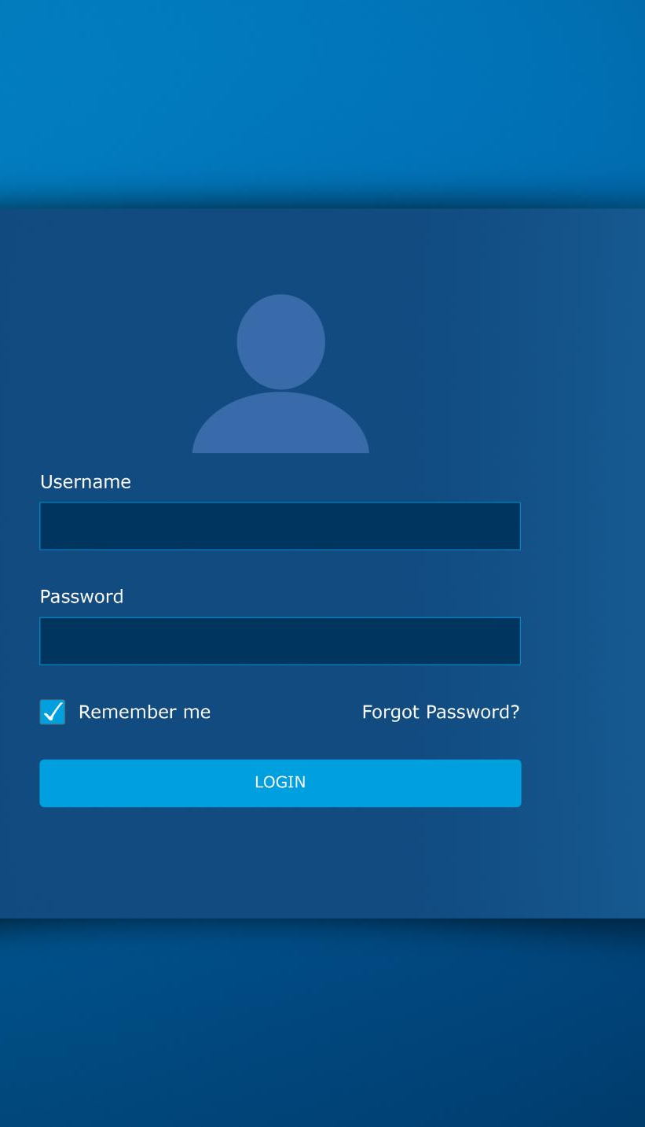
Request and Approval Experience for Agents (MC1134738)
New Access Request Process
Users can request access to agents directly through the centralized Agent Store in the Microsoft 365 admin center.
Centralized Admin Management
Administrators manage all agent access requests centrally, enhancing control and oversight over permissions.
Seamless Rollout
The feature is enabled by default, requiring no configuration, with rollout scheduled from late September to mid-October 2025.
Improved Flexibility and Transparency
This update enhances flexibility and transparency in managing agent access within the Microsoft 365 environment.
Notes:
Microsoft is introducing a new request and approval experience for Microsoft-built agents in the Microsoft 365 admin center. Users can request access to agents directly from the Agent Store, and admins can manage these requests centrally. The feature is on by default and requires no configuration. Rollout begins late September and completes mid-October 2025. This update improves flexibility and transparency in agent access management. The message ID for this update is MC1134738.

Slide 18
SharePoint Agents in Teams Channels
Notes:
Interact with SharePoint Content via Agents (MC1137613)

Slide 19
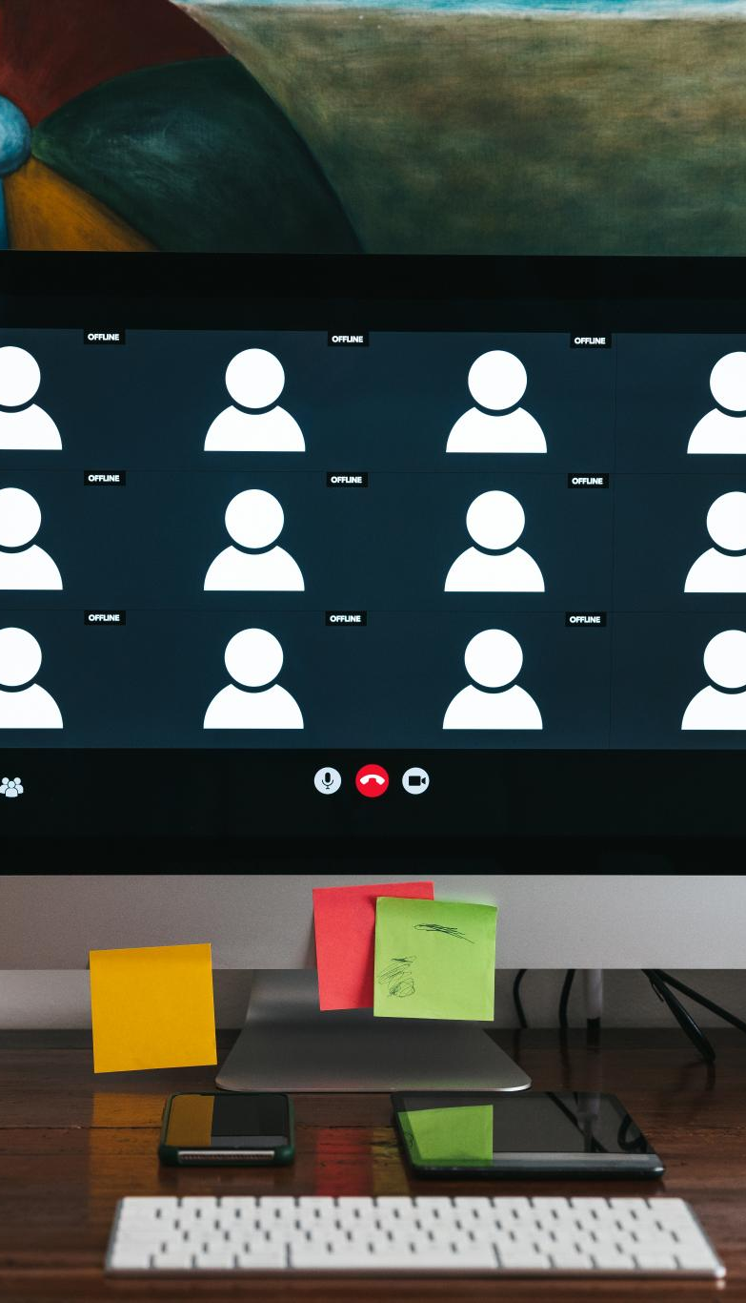
Interact with SharePoint Content via Agents (MC1137613)
Seamless Content Access
Users can access and summarize SharePoint content directly within Teams Channels using @mentions, enhancing workflow efficiency.
Productivity Enhancement
Integrating SharePoint with Teams improves productivity by centralizing organizational knowledge in one platform.
Governance and Compliance
The feature supports existing governance and compliance controls ensuring secure and compliant data access.
Rollout Timeline
The feature rollout starts late August and completes mid-September 2025, enabling default access to all users.
Notes:
SharePoint agents in Microsoft Teams Channels enable users to access and summarize SharePoint content using @mentions without leaving Teams. This feature enhances productivity by providing seamless access to organizational knowledge within Teams Channels. It is enabled by default and supports existing governance and compliance controls. The rollout begins late August and completes mid-September 2025. The message ID for this update is MC1137613.

